Slide 1
Design and Implement Cloud Data Platform Solutions

Slide 2
07 | Monitor and Manage Implementations on Azure

Slide 3
Agenda
1
Microsoft Data Platform
5
Hybrid HA/DR Scenarios with SQL Server
2
Implement SQL Server on Azure VM
6
Design and Implement Security
3
Implement SQL Database
7
Monitor and Manage Implementations on Azure
4
SQL Database High Availability and Disaster Recovery
8
Design and implement database solutions for SQL Server and SQL Database

Slide 4
In this module
Azure Automation Capabilities
SQL Monitoring and Management
Operational Insights

Slide 5
Azure Automation and Monitoring

Slide 6
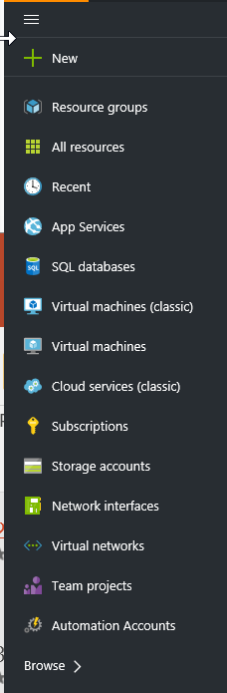
Azure Automation Capabilities
Runbook Authoring in Azure:
Create runbooks to automate all aspects of cloud operations, from deployment, monitoring, and optimizations
Highly Available Engine:
Support requirements for scale and H/A.
Built on PowerShell Workflow. Isolation for runbook jobs
Integration into other systems:
Import PS modules and create additional modules and runbooks for Azure services or to connect into 3rd party systems
Azure
Automation
Backup SQL Azure on a schedule
Patch Azure VMs without downtime
Remediate alert on a service
Staged deployment of a service
Monitoring
Systems
Change
Control
Systems
Anything ☺

Slide 7
Demo
Azure Automation and Runbook

Slide 8
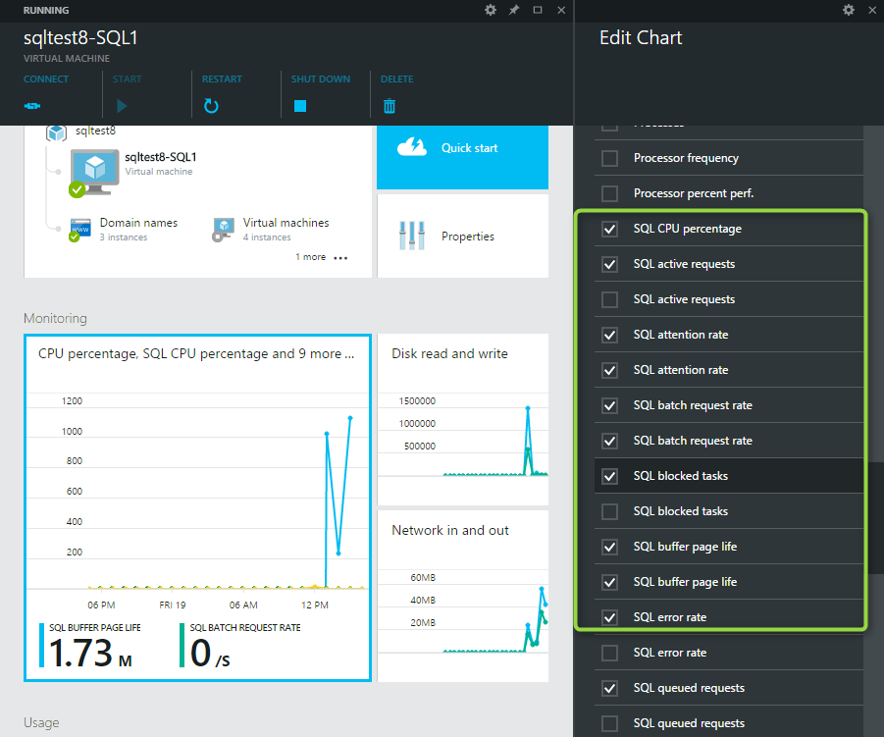
SQL Monitoring and Management
Auto-HA/AlwaysOn
Monitoring and Diag
Auto-Patch
Auto-Backup
Auto-Encrypt

Slide 9
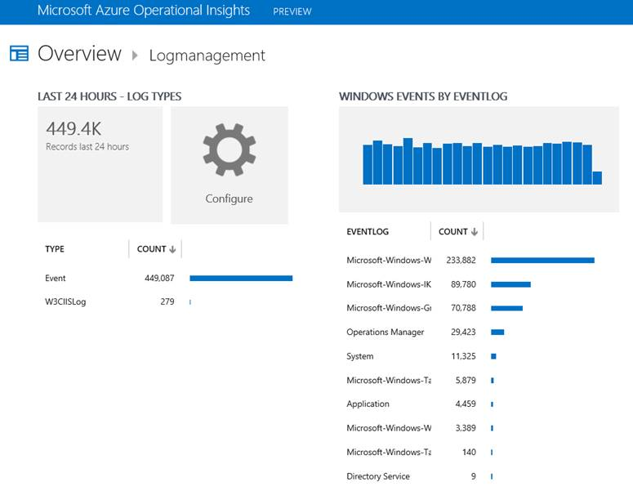
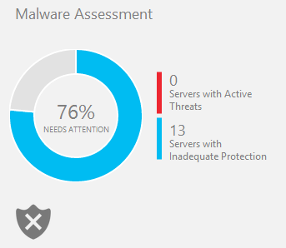
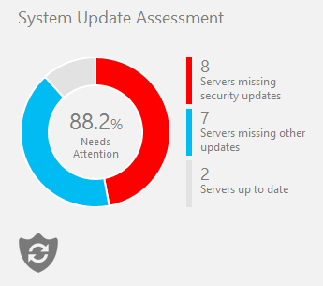
Operational Insights
Manage, search, and build insights
Log management and analysis
Monitor, troubleshoot, store

Slide 10
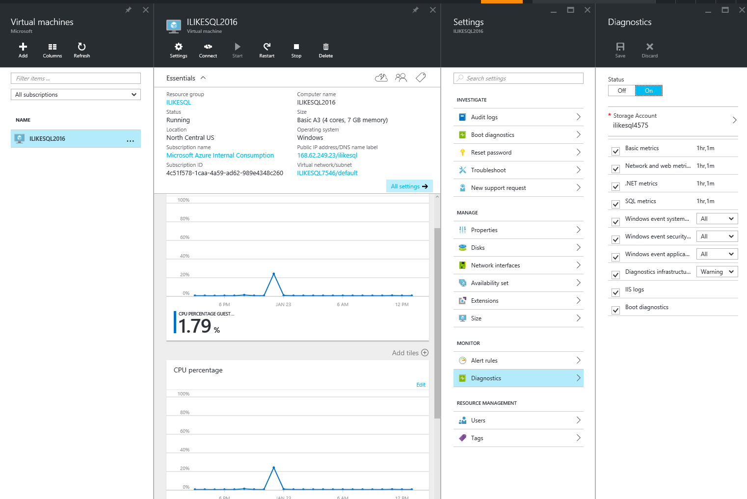
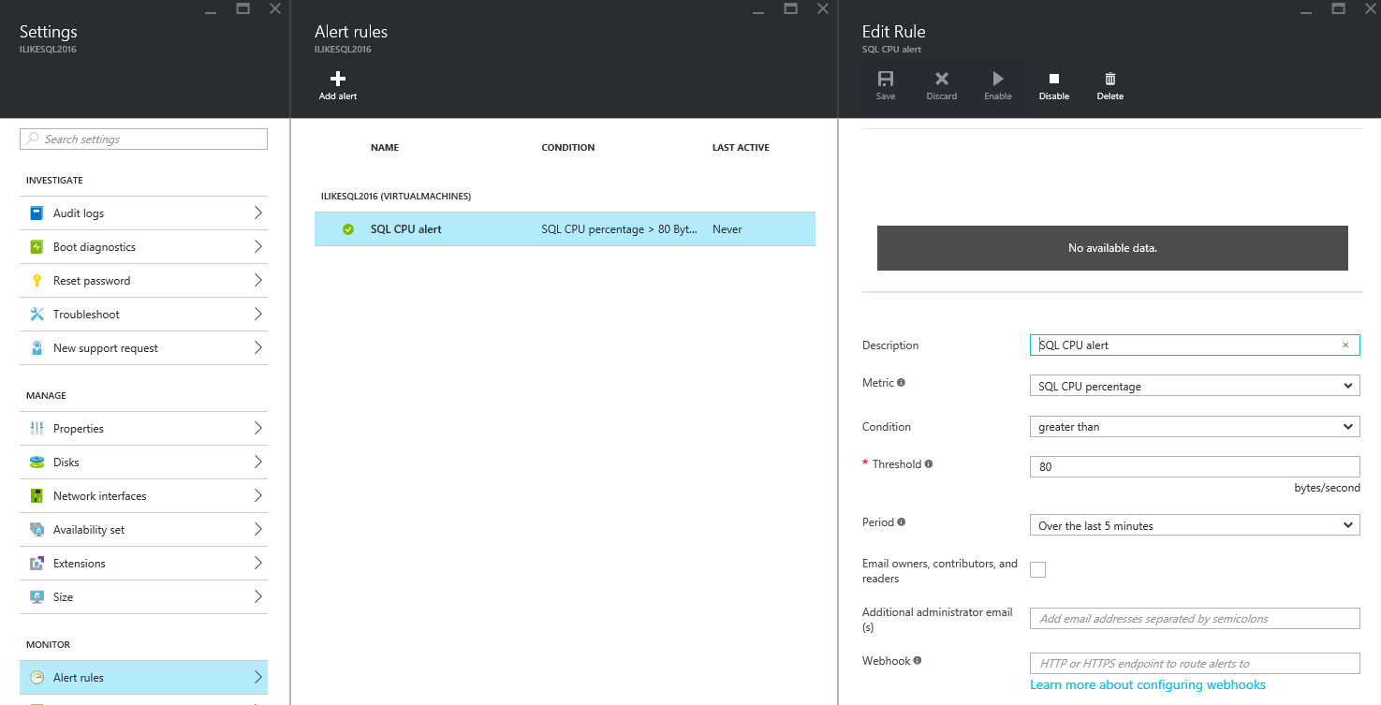
Azure Monitoring
Enable diagnostics
View boot diagnostics
Enable alert rules

Slide 11
Demo
Azure VM Monitoring

Slide 12
Hands-on Lab
Monitoring and manage implementations

